Slide 1
Addressing Crash Recovery with Persistent Memory Allocation
Advisors: Dr. Michael Spear Dr. Roberto Palmieri
Student: Nick Stone

Slide 2
Recall from the Last Talk
Persistent Memory
Preserves its contents upon power off
Write endurance = ~10⁹ to 10¹¹ stores
Latency = ~2x DRAM access
Byte-addressable

Slide 3
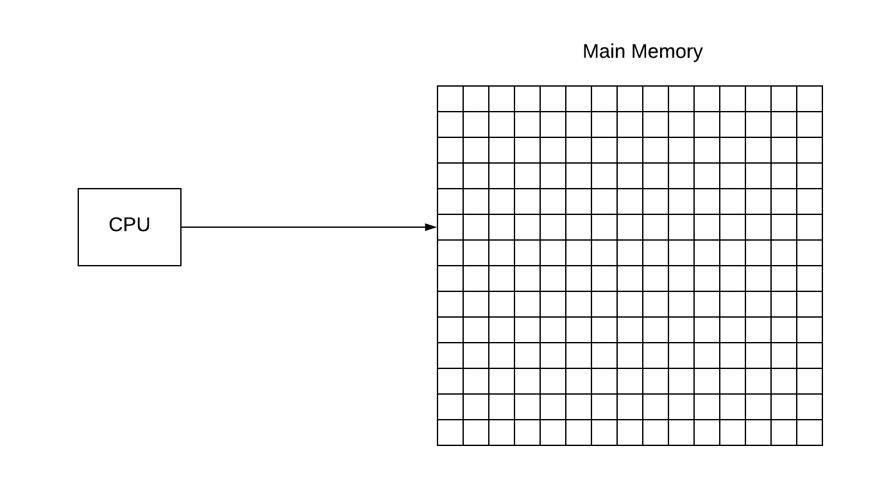
Visualization of Memory Management

Slide 4
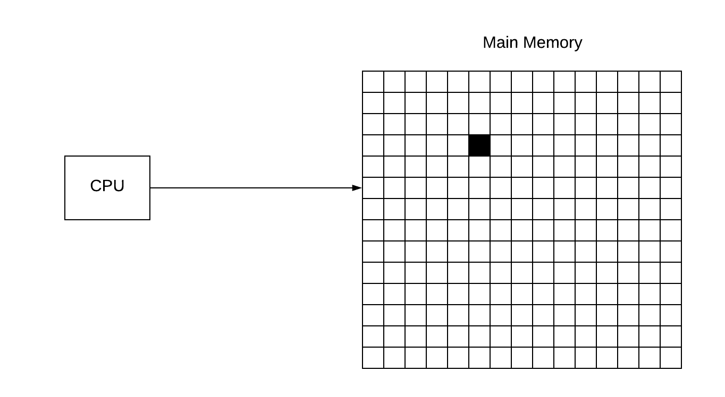
Visualization of Memory Management

Slide 5
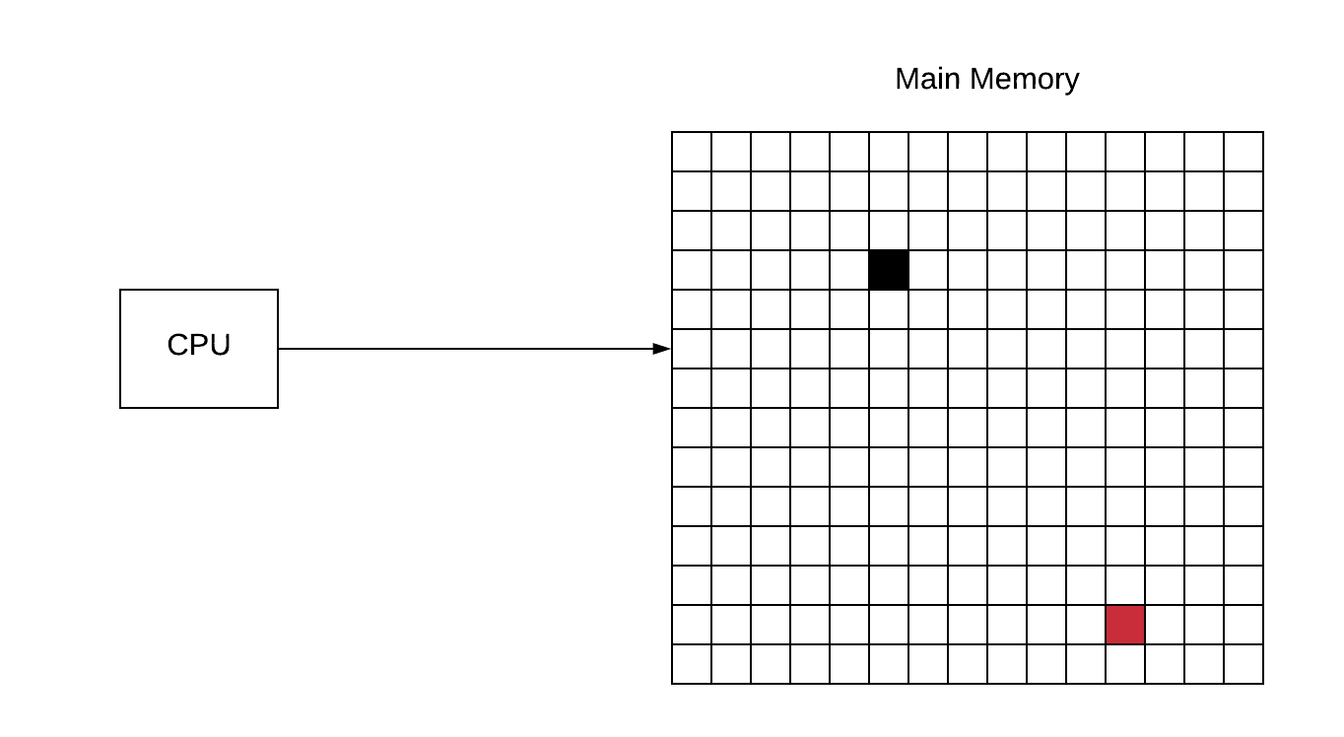
Visualization of Memory Management

Slide 6
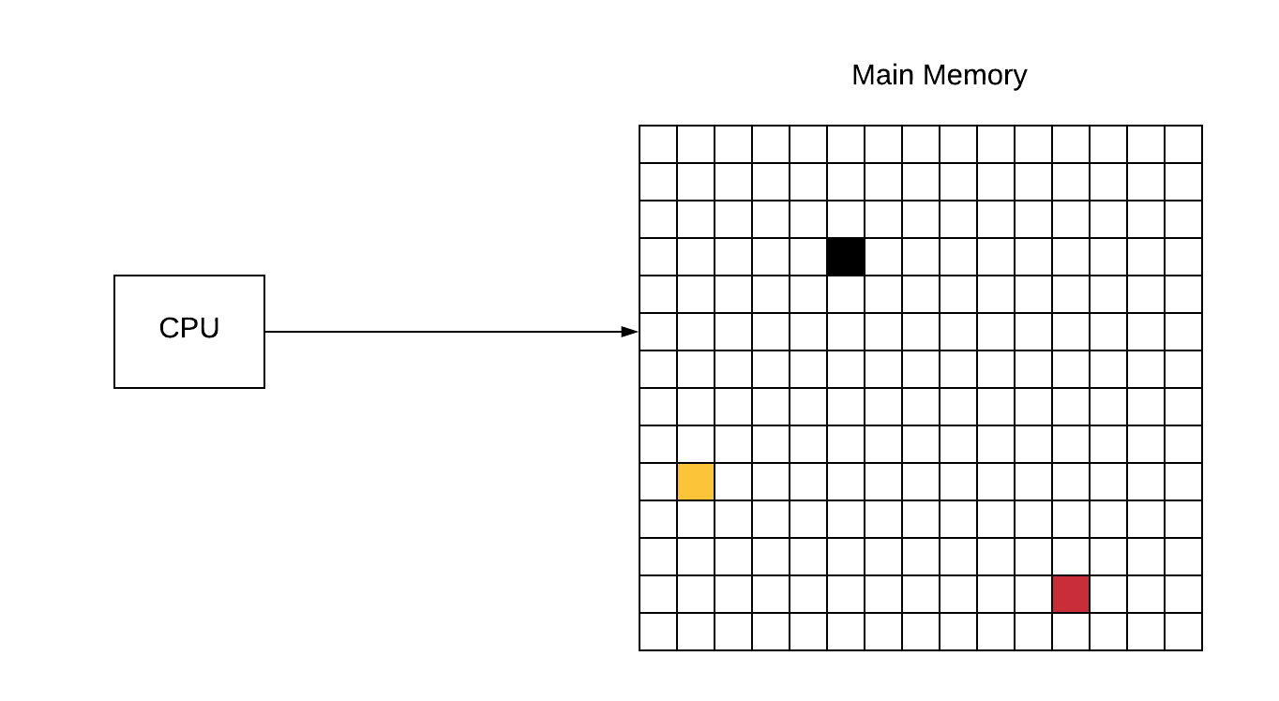
Visualization of Memory Management

Slide 7
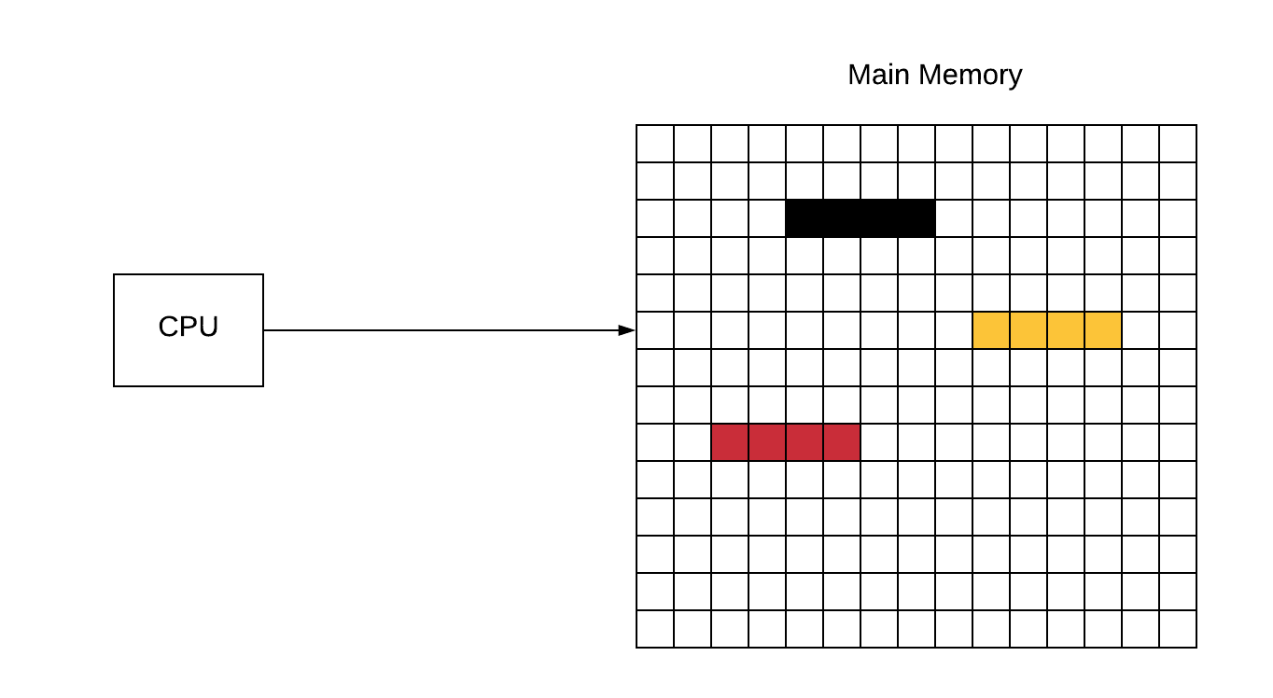
Visualization of Memory Management

Slide 8
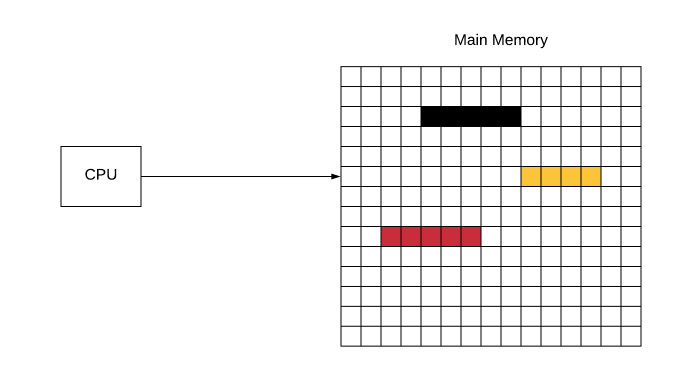
Visualization of Memory Management

Slide 9
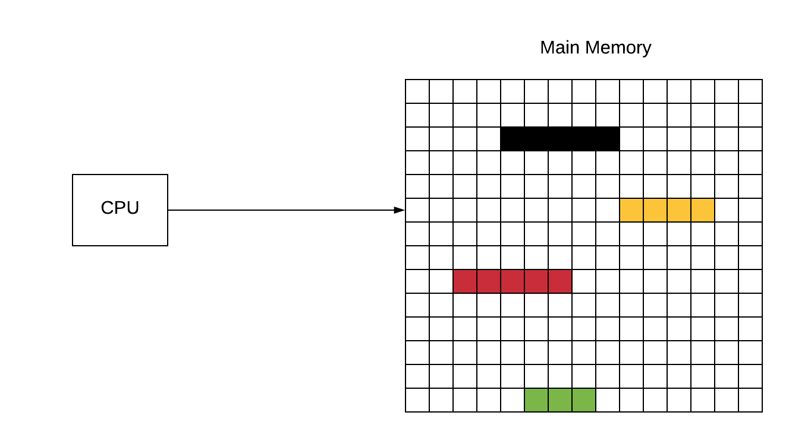
Visualization of Memory Management

Slide 10
Locality

Slide 11
Arena Allocation

Slide 12
Allocators The good The bad….and the Quirky

Slide 13
Hoard Multi Threaded Memory Management

Slide 14
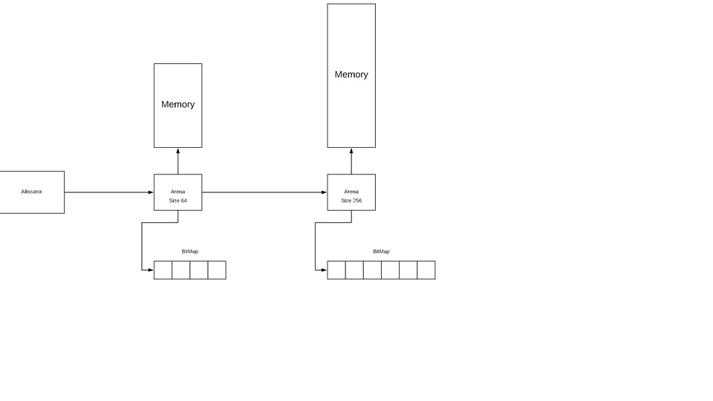
Iteration 1

Slide 15
Experimental Results

Slide 16
Problems

Slide 17
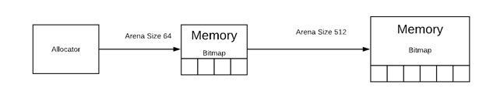
Iteration 2

Slide 18
Problems

Slide 19
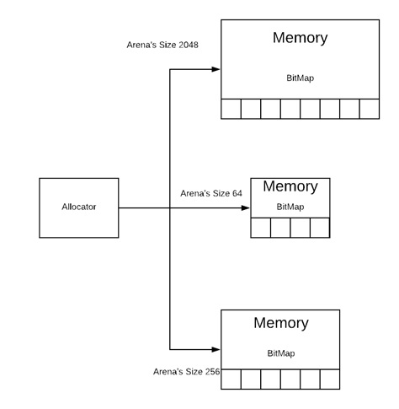
Iteration 3

Slide 20
Problems

Slide 21
Next Steps

Slide 22
Conclusion

Slide 23
References

